Slide 2
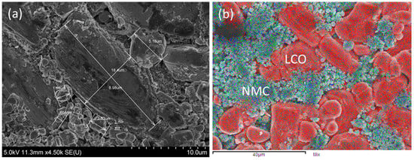
Hawaii Natural Energy Institute (HNEI)
The dataset from HNEI used in the publication "Intrinsic Variability in the Degradation of a Batch of Commercial 18650 Lithium-Ion Cells" consists of commercial 18650 cells with a graphite negative electrode and a blended positive electrode composed of NMC and LCO. The cell was cycled at 1.5C to 100% DOD for more than 1000 cycles at room temperature. This study examines the influence of intrinsic cell-to-cell variations on aging.

Slide 3
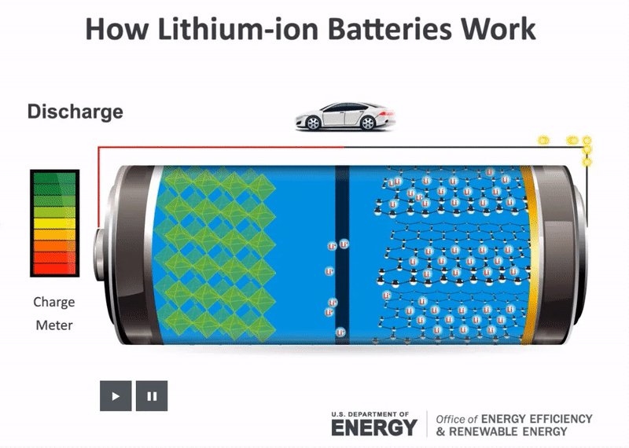
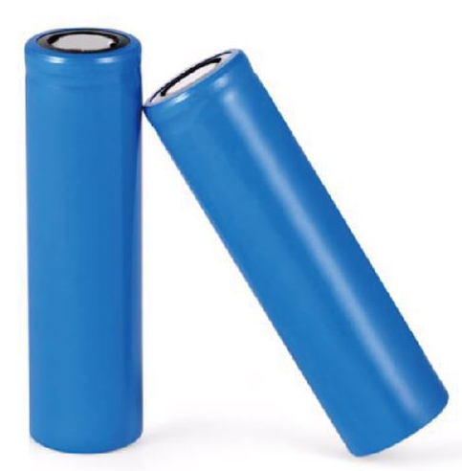
Charging: The electrons are forced to released at the cathode and move externally to the anode.
Simultaneously, the Li-ions move in the same direction, but internally, from cathode to anode via the electrolyte.
Discharging: The electrons move from anode to cathode through external load.
Simultaneously, the Li-ions move in the same direction, but internally, from anode to cathode via the electrolyte.
Notes:
The electrons are forced to be released at the cathode and move externally to the anode. Simultaneously the lithium ions move in the same direction, but internally, from cathode to anode via the electrolyte. In this way the external energy are electrochemically stored in the battery in the form of chemical energy in the anode and cathode materials with different chemical potentials. The opposite occurs during discharging process: electrons move from anode to the cathode through the external load to do the work and Li ions move from anode to the cathode in the electrolyte. This is also known as “shuttle chair” mechanism, where the Li ions shuttle between the anode and cathodes during charge and discharge cycles.
LiPF₆ can react with water to form highly corrosive HF. Therefore, moisture must be minimized in handling of LiPF₆ electrolyte.
The recent news on fires of Li‐ion batteries, involving the Boeing 787 passenger aircrafts, Tesla Model S cars, highlights the importance of battery safety.

Slide 4
Features
Cycle_Index
Discharge Time (s)
Decrement 3.6-3.4V (s)
Max. Voltage Dischar. (V)
Min. Voltage Charg. (V)
Time at 4.15V (s)
Time constant current (s)
Charging time (s)
RUL

Slide 5
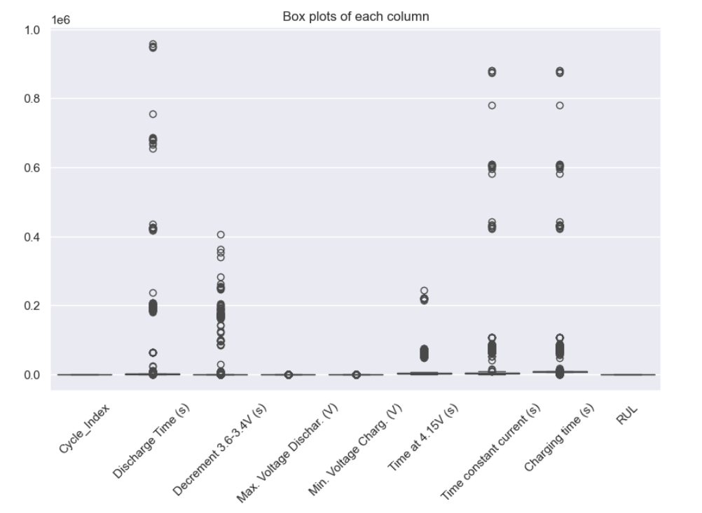
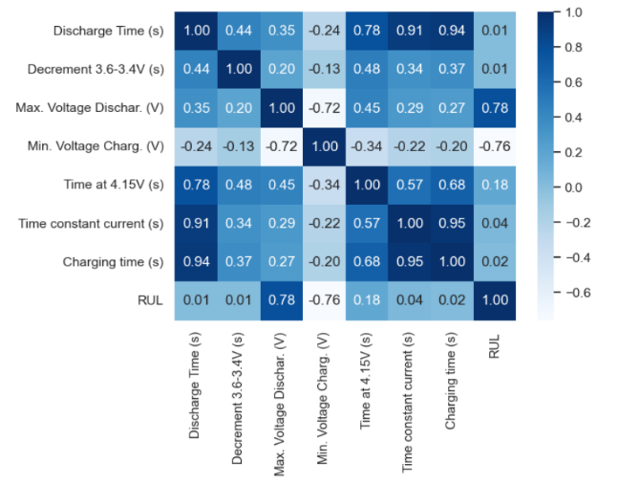

Slide 6
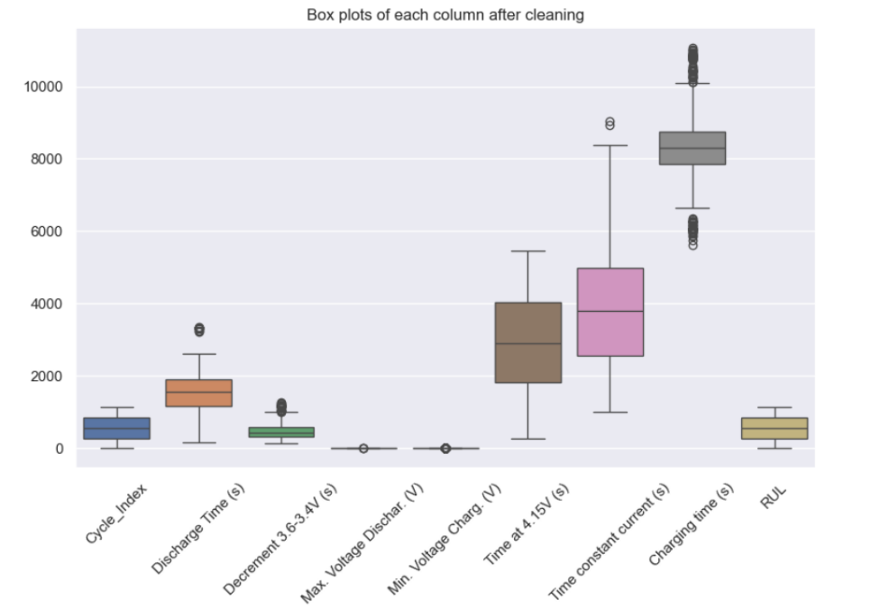
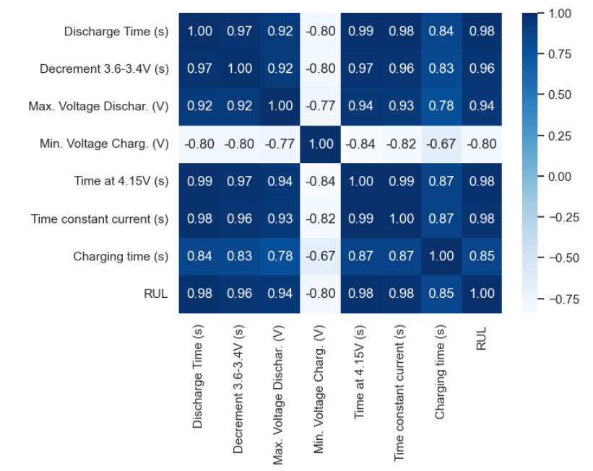

Slide 7
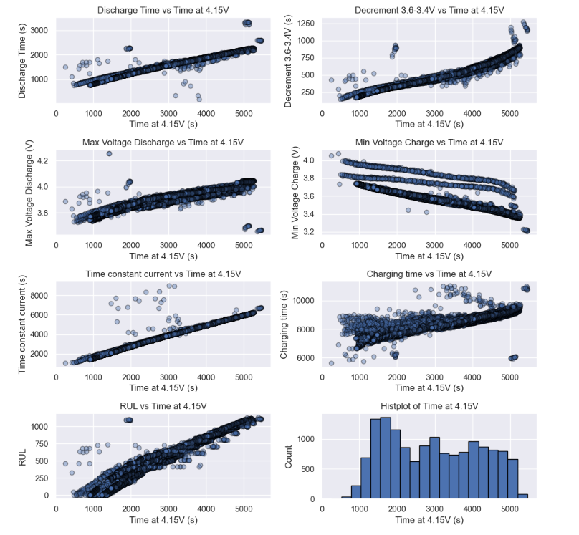

Slide 8
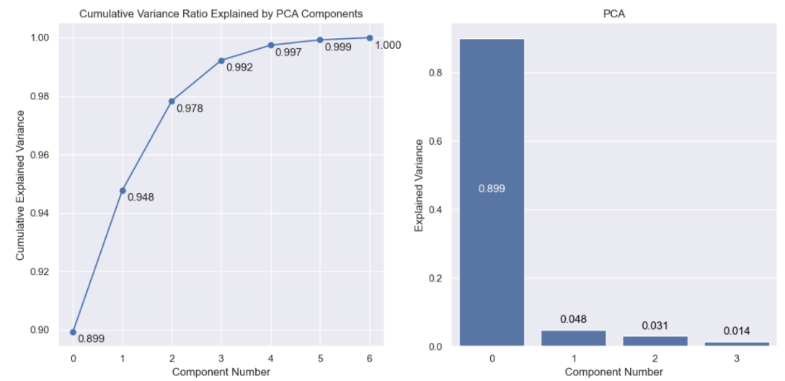

Slide 9
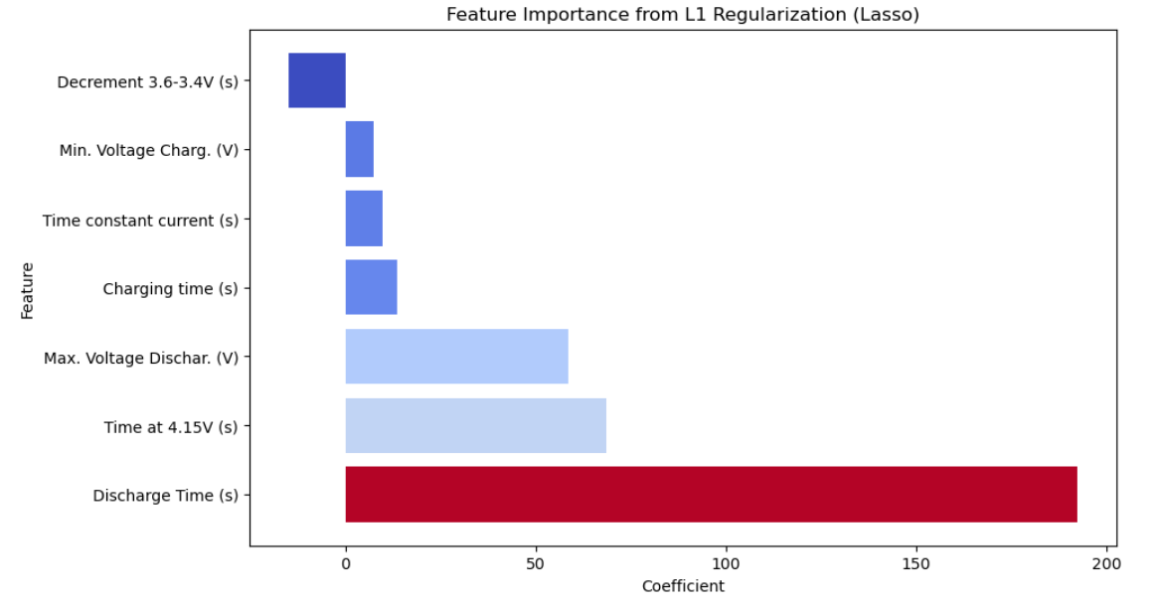
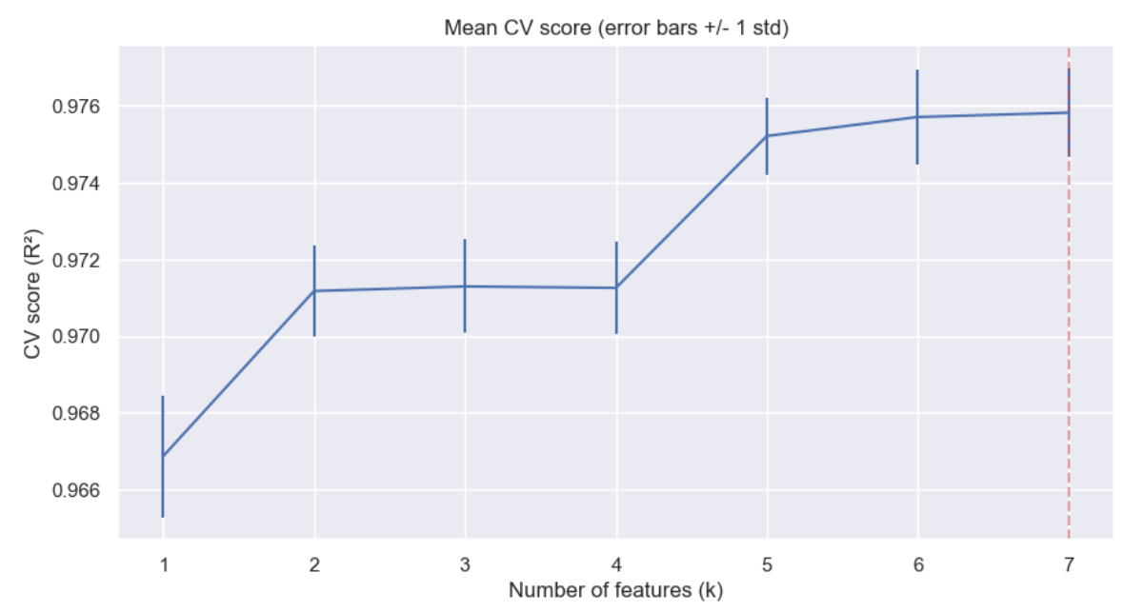

Slide 10
